Slide 1
SQL Capstone Project @Odinschool Amazon Sales Data Name: Janaki G S7886

Slide 2
Contents:
Project Overview & Scope
Business Problem
Business Objectives and Constraints
Technical Stacks
Data Collection and Understanding
Data Dictionary
System Requirements
Data Preprocessing
Exploratory Data Analysis
Challenges
Recommendations

Slide 3
Project Overview :
The project aims to analyze sales transactions data from 3 branches of Amazon to derive actionable insights for business decision-making. By leveraging data analytics techniques, the project seeks to uncover trends, patterns, and opportunities within the dataset to drive growth, enhance competitiveness, and improve overall business performance.
Scope:
The scope of the project encompasses data exploration, preprocessing, analysis, and visualization to derive actionable insights. The project aims to provide valuable insights that support data-driven decision-making and contribute to the achievement of business objectives.

Slide 4
Business Problem:
The dataset addresses several key business problems aimed at improving overall business performance. These include:
Sales Optimization: Understanding and improving sales performance across branches and product lines to increase revenue.
Customer Segmentation and Engagement: Tailoring marketing efforts and enhancing customer engagement through effective segmentation and targeted strategies.
Product Management: Assessing product performance and optimizing offerings based on customer preferences and market trends.
Operational Efficiency: Improving inventory management and streamlining operational processes to reduce costs and improve service quality.

Slide 5
Marketing Effectiveness: Evaluating the impact of marketing campaigns and optimizing marketing strategies to maximize return on investment.
Profitability Analysis: Analyzing profitability across different segments to identify opportunities for cost reduction and revenue enhancement.
Customer Satisfaction: Measuring and enhancing customer satisfaction levels to foster loyalty and improve overall customer experience.
Market Trends and Competition: Monitoring market trends and competitor activities to stay competitive and capitalize on emerging opportunities.
By addressing these business problems and leveraging insights from the dataset, our organization can make informed decisions to drive growth, enhance competitiveness, and improve overall business performance.

Slide 6







Technical Stocks:

Slide 7
Data Collection and Understanding:
This dataset contains sales transactions from three different branches of Amazon A, B, C, respectively located in Mandalay, Yangon and Naypyitaw and having 5 product lines namely Food and Beverages, sports and travel,home and lifestyle,Electronic accessories,Health and Beauty and Fashion accessories
Data Dictionary:
Here is the list of column names:
invoice_id,branch,city,customer type,gender,product line,unit price,quantity,vat,total,date,time,payment,cogs,gross margin percentage,gross income,rating
Data Dimension:
1000 rows x 20 columns(After data preprocessing)

Slide 8
Data Dictionary:
Column | Description | Data Type
invoice_id | Invoice of the sales made | VARCHAR(30)
branch | Branch at which sales were made | VARCHAR(5)
city | The location of the branch | VARCHAR(30)
customer_type | The type of the customer | VARCHAR(30)
gender | Gender of the customer making purchase | VARCHAR(10)
product_line | Product line of the product sold | VARCHAR(100)
unit_price | The price of each product | DECIMAL(10, 2)
quantity | The amount of the product sold | INT
VAT | The amount of tax on the purchase | FLOAT(6, 4)
total | The total cost of the purchase | DECIMAL(10, 2)
date | The date on which the purchase was made | DATE
time | The time at which the purchase was made | TIMESTAMP
payment | The total amount paid | Varchar(20)
cogs | Cost Of Goods sold | DECIMAL(10, 2)
gross_margin_percentage | Gross margin percentage | FLOAT(11, 9)
gross_income | Gross Income | DECIMAL(10, 2)
rating | Rating | FLOAT(2, 1)

Slide 9
System Requirements
--Operating System: Windows 10
--System Type: 64 bit Operating System,x64-based processor
--Ram:8GB
--Processor: 11th Gen Intel(R) Core(TM) i3-1115G4 @ 3.00GHz 3.00 GHz
Data Preprocessing:
--The first step in data preprocessing is to identify the columns with missing values. In this case, There are no null values in our database as in creating the tables, we set NOT NULL for each field, hence null values are filtered out.
--Added 3 new columns for extracting additional information such as time of day, day of the week, and month of the year from the existing columns (time and date) for understanding sales patterns by time of day (morning, afternoon, evening) and different timescales (daily, weekly, monthly) can help identify peak hours for sales, while analyzing sales trends by day of the week and month of the year can reveal recurring patterns and seasonal variations.

Slide 10
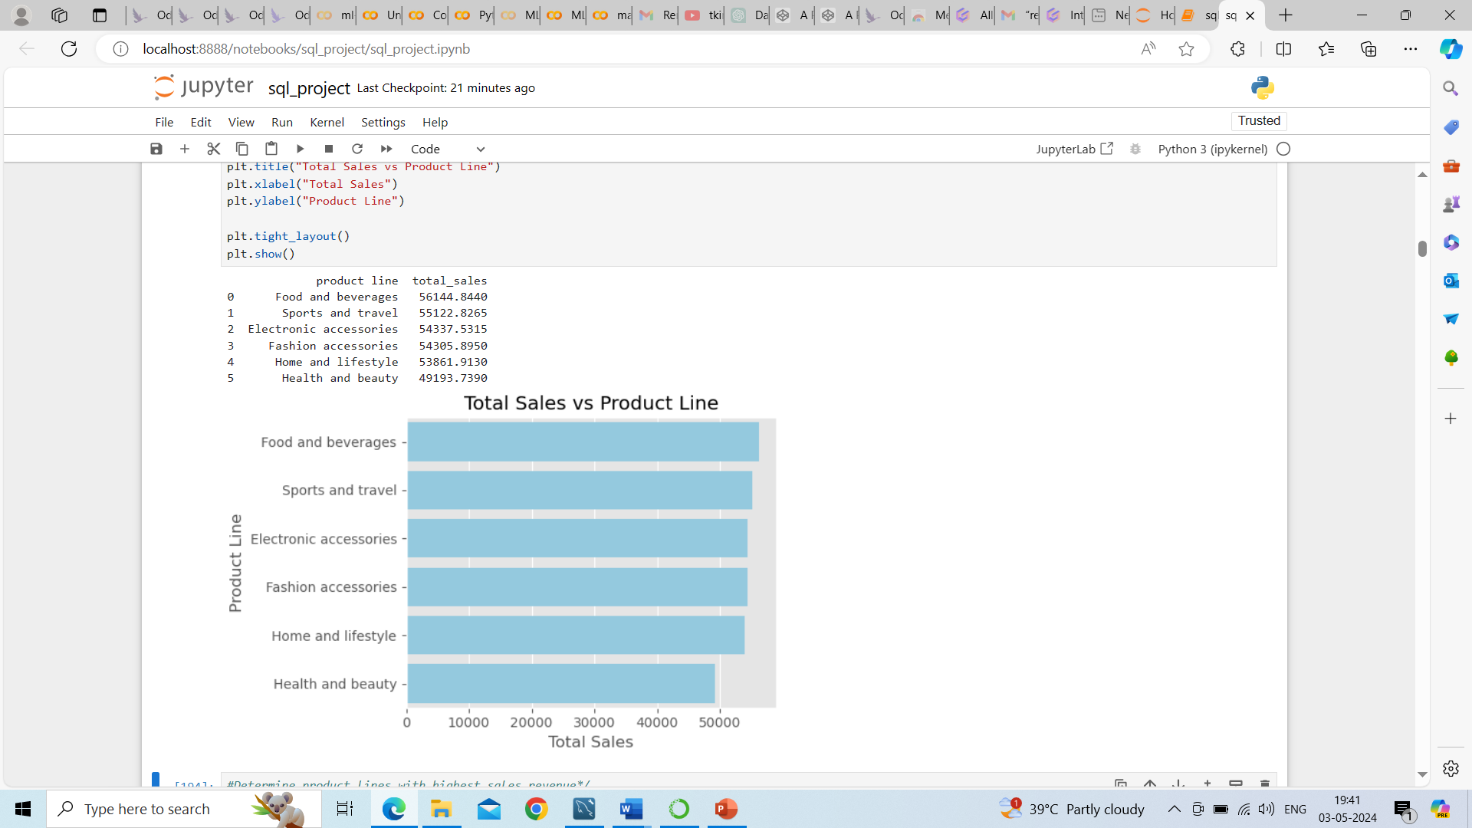
Exploratory Data Analysis: Data Visualization
Product Analysis:
There are 3 Branches in the dataset
Namely Mandalay, Yangon and
Naypyitaw and having 5 product lines
conducted product analysis on the dataset to understand the different product lines. identified the best-performing product lines, and determined areas for improvement.
1.Determine which product lines generate the highest sales revenue.Calculated the total sales for each product line.
Hieghest sales revenue:
Food And Beverages
Lowest sales revenue:
Health and beauty

Slide 11
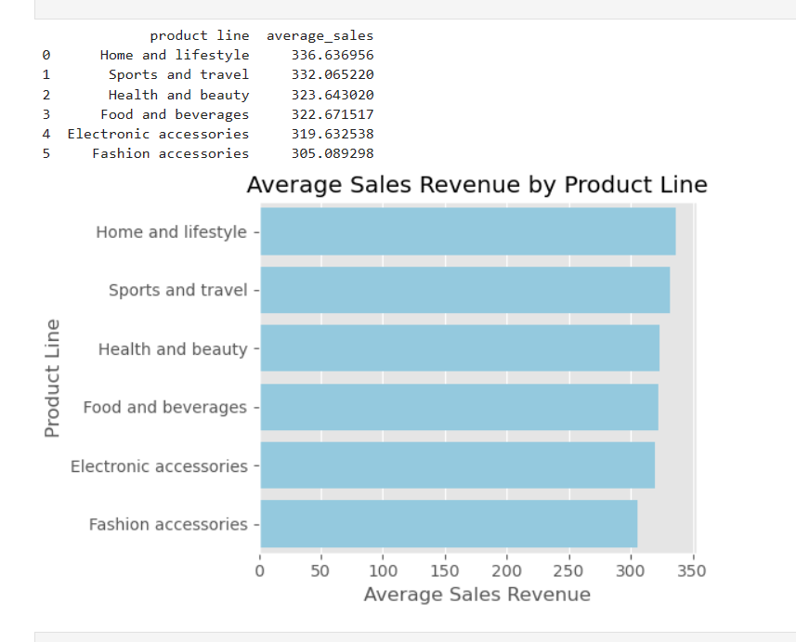
Exploratory Data Analysis: Data Visualization -bar plot
Product Analysis:
2. Evaluate Product Line Performance.
Calculated average sales or revenue for each product line to assess performance.
Hieghest avg sales revenue:
Home and lifestyle
Lowest avg sales revenue:
Fashion accessories

Slide 12
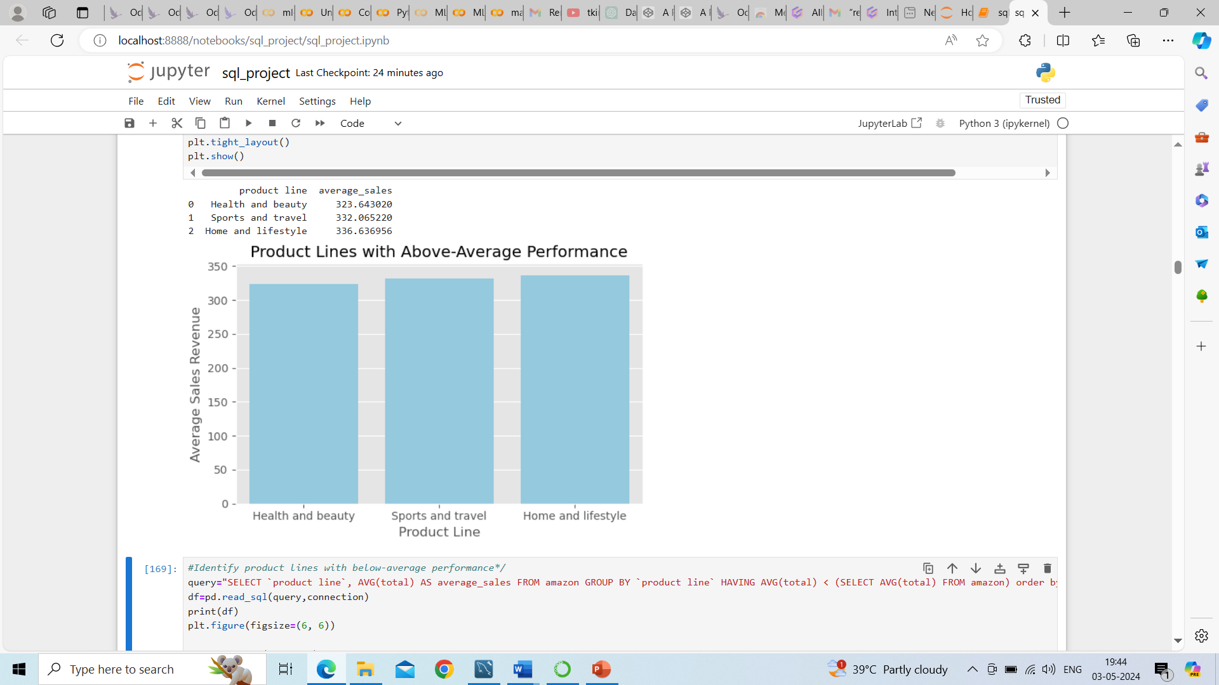
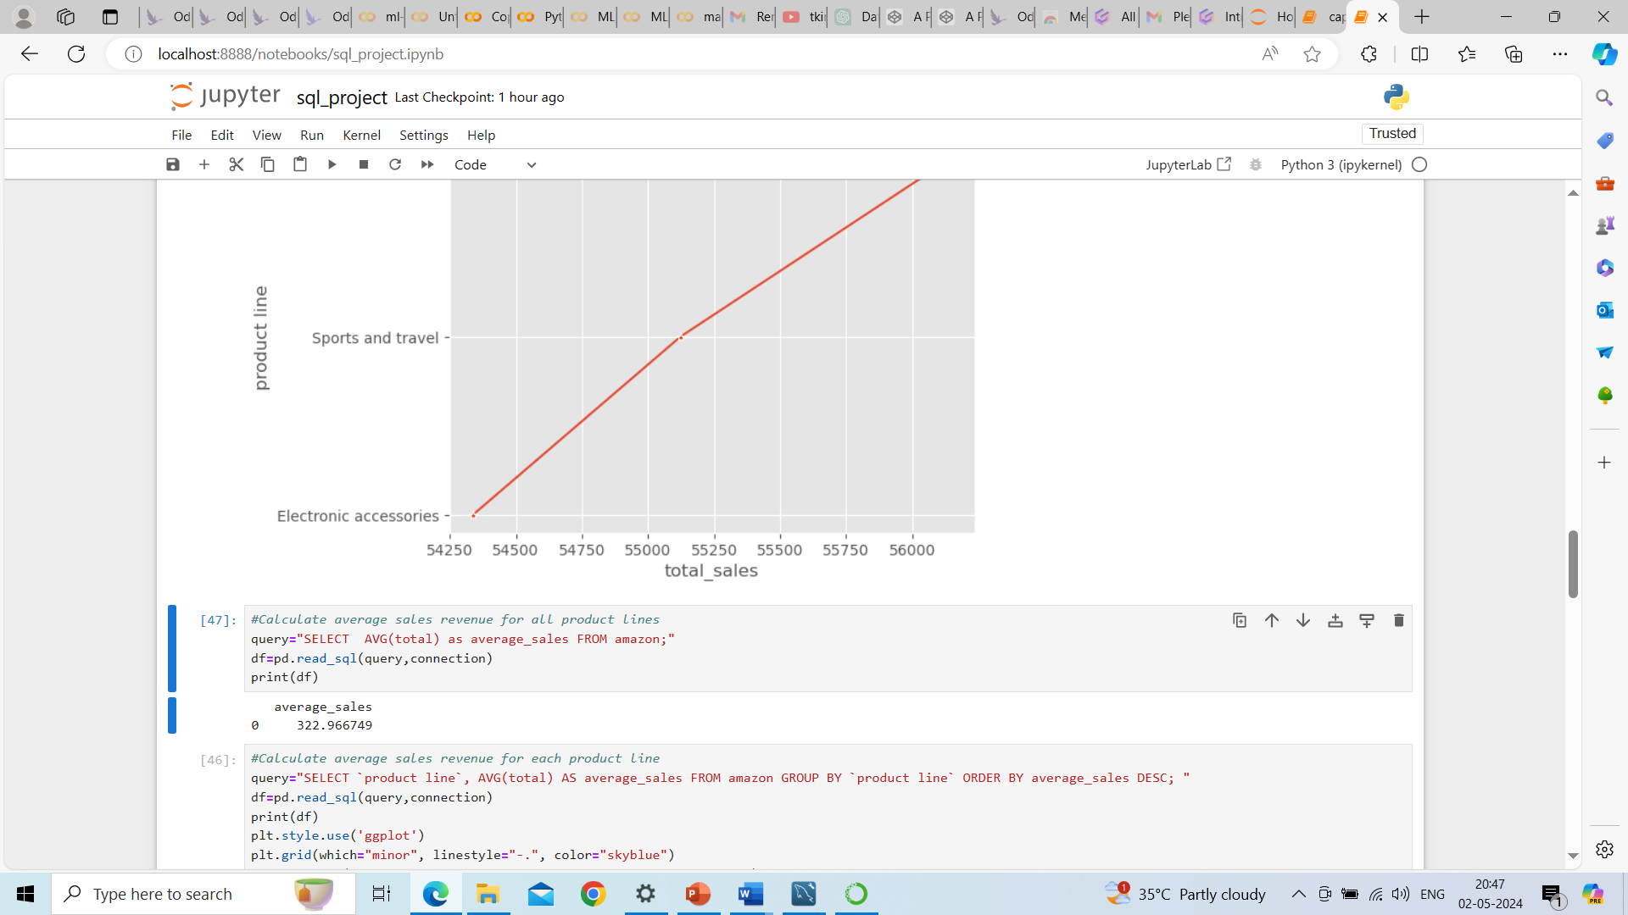
Exploratory Data Analysis: Data Visualization -bar plot
Product Analysis:
3. Identified product lines with above-average performance
Avg sales of total product lines with all branches:
Above-average performance :
Health and Beauty
Sports and travel
Home and lifestyle

Slide 13
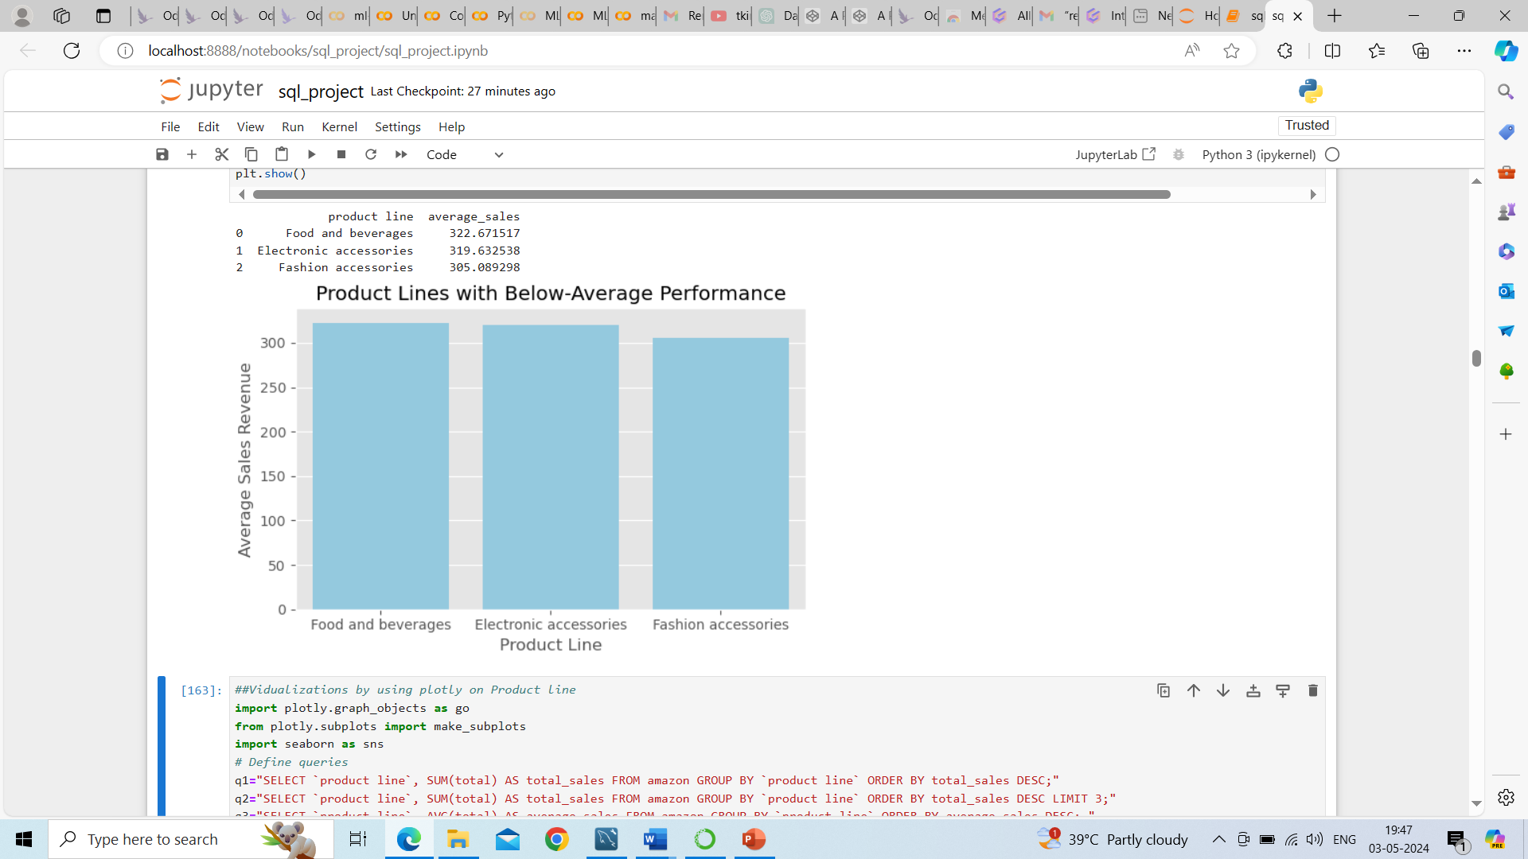
Exploratory Data Analysis: Data Visualization –BAR plot
Product Analysis:
4. Identified product lines with below-average performance
Avg sales of total product lines with all branches:
Below-average performance :
Food and beverage
Electronic accessories
Fashion accessories

Slide 14
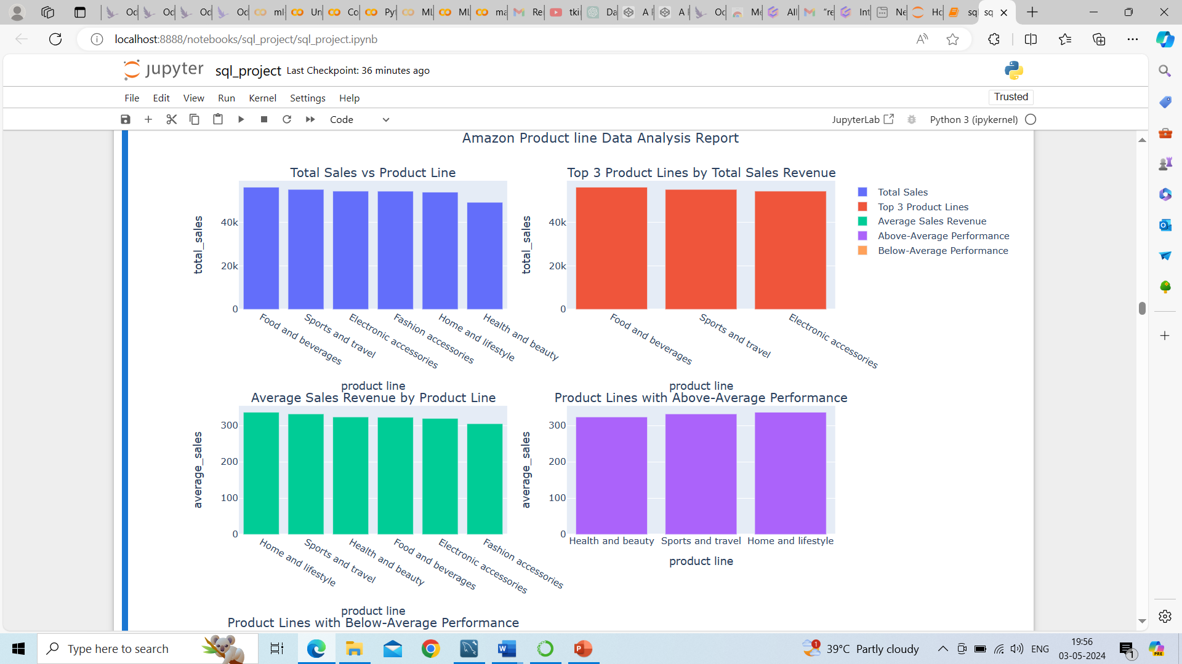
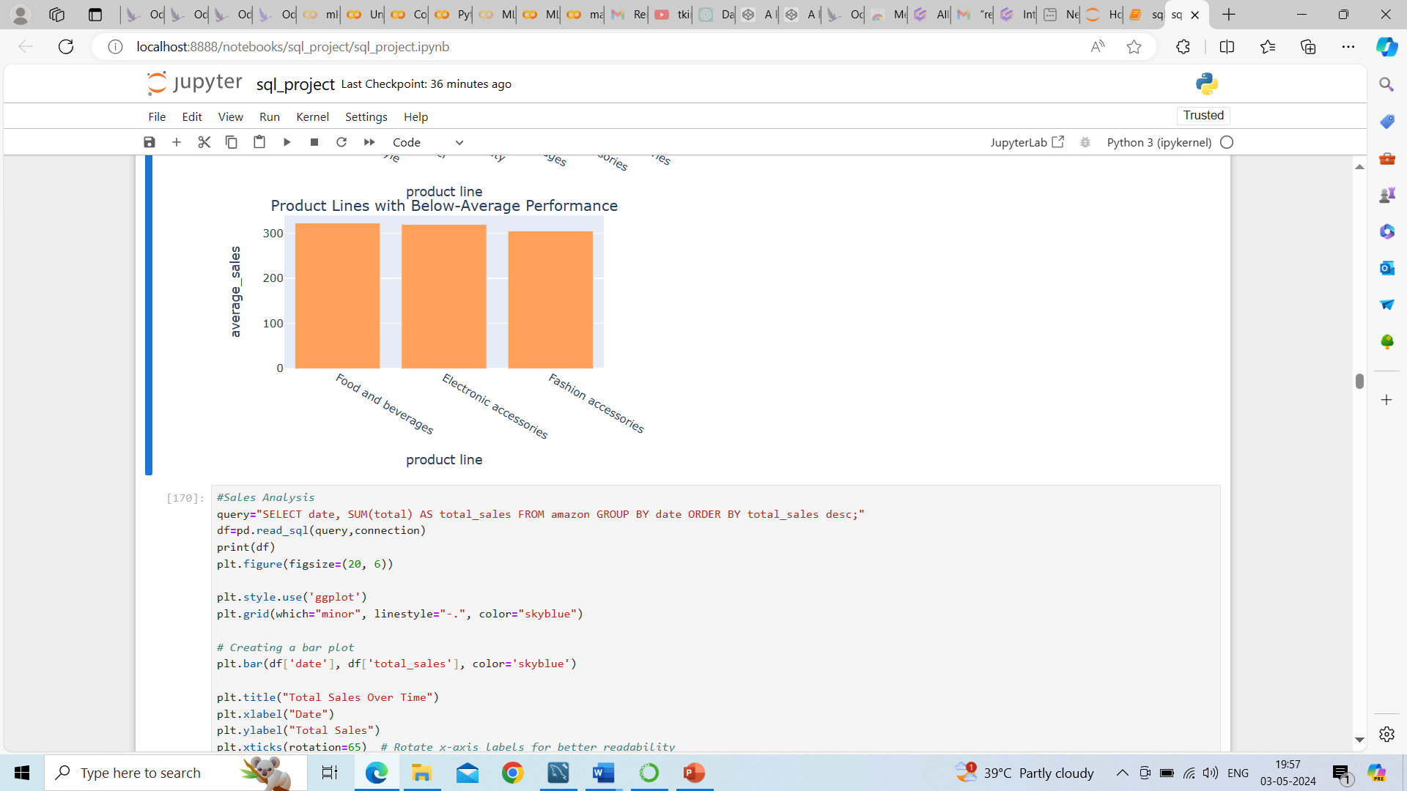

Slide 15
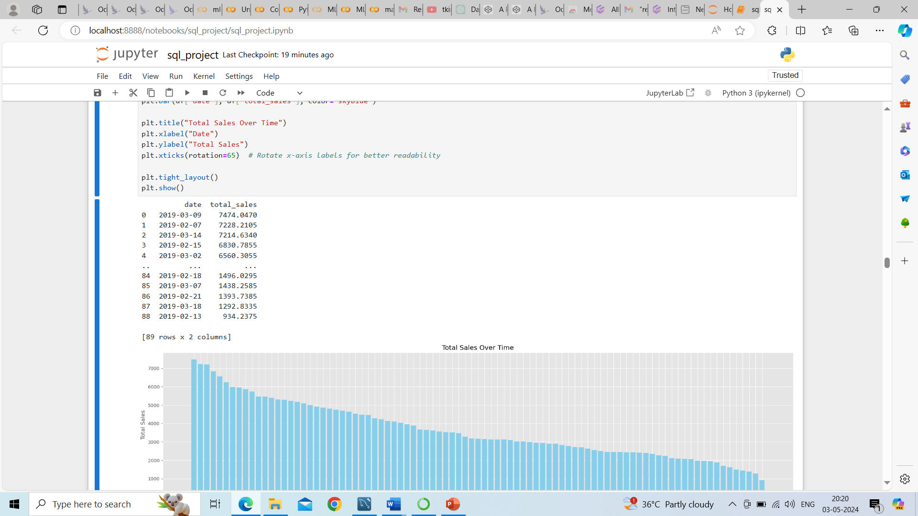
Exploratory Data Analysis: Data Visualization
2019-03-09
Sales Analysis:
1. To conduct a sales analysis aiming to understand sales trends of products, measure the effectiveness of sales strategies the business applies and what modifications are needed to gain more sales.
Calculated the trend of total sales over time
Highest sales generated on 2019-03-09
Least sales generated on 2019-02-13

Slide 16
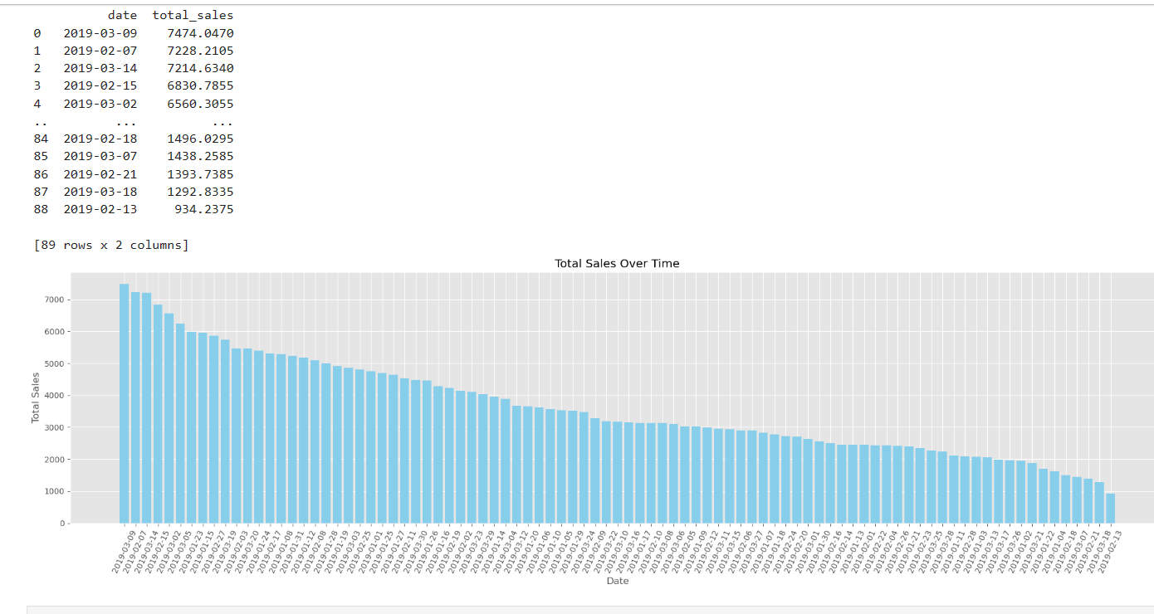
Data Visualization -BAR PLOT

Slide 17

Exploratory Data Analysis: Data Visualization -bar plot
Sales Analysis:
2. Evaluate Sales Performance by Product Line:
Calculated total sales for each product line to identify top-selling product lines
Analyzed sales trends for each product line over time to understand their performance.
Calculated the trend of total sales over time
Highest sales generated with Food and Beverages product line
Lowest sales generated with Health and beauty

Slide 18
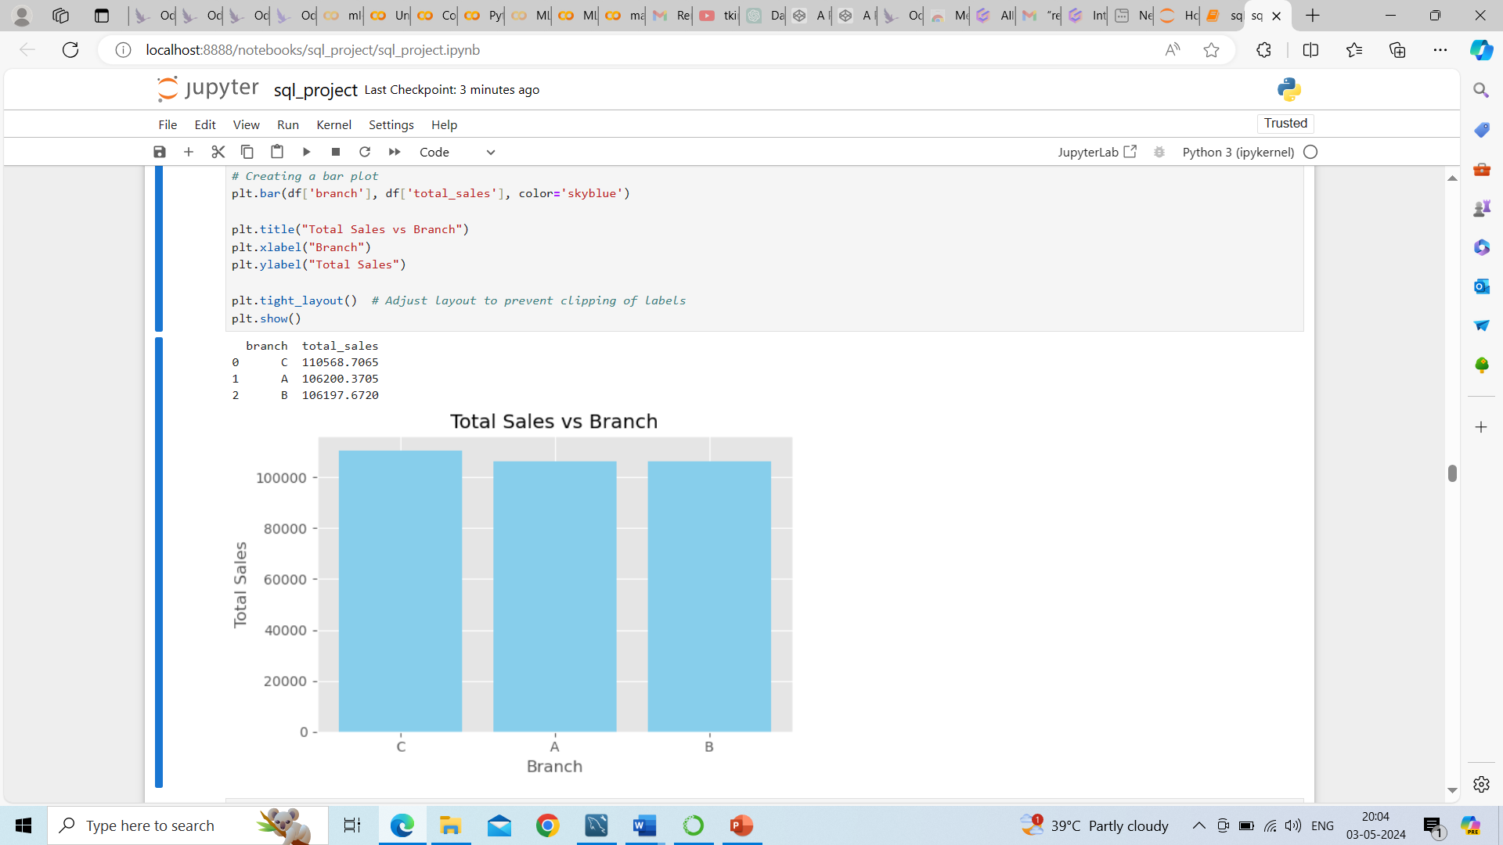
Exploratory Data Analysis: Data Visualization -bar plot
Sales Analysis:
3. Assess Sales Performance by Branch:
--Calculated total sales for each branch to identify top-performing branches.
--Highest sales at Branch C
----Lowest sales on Branch B

Slide 19
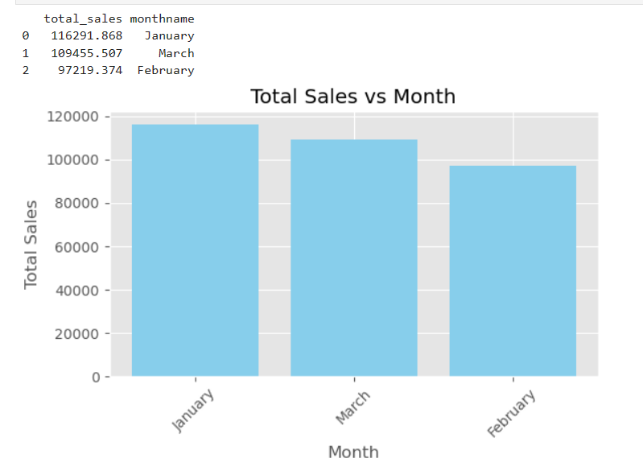
Exploratory Data Analysis: Data Visualization -bar plot
Sales Analysis:
4. Identified Seasonal Trends::
--Analyzed sales data to identify seasonal trends or patterns in sales.
--we can aggregated sales data by month or quarter and visualize the trend.• Determine peak seasons or months with highest sales and off-peak seasons.
--Highest sales on January
-- Lowest sales on February

Slide 20
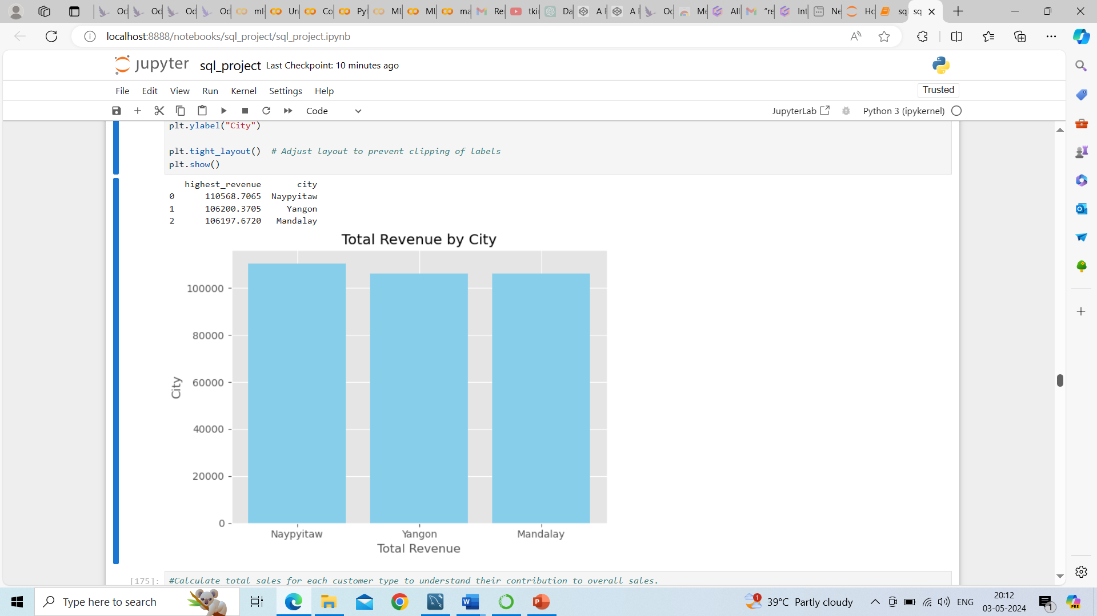
Exploratory Data Analysis: Data Visualization -bar plot
Sales Analysis:
5. Identified In which city was the highest revenue recorded
--Highest revenue generated at Naypyitaw City
--Lowest revenue generated at Mandalay City

Slide 21
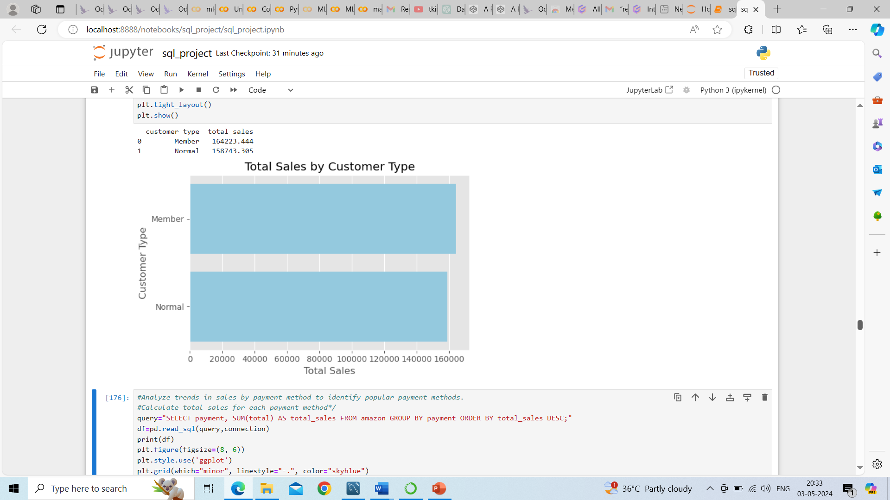
Exploratory Data Analysis: Data Visualization -bar plot
Sales Analysis:
6. Calculated total sales for each customer type to understand their contribution to overall sales.
--Amazon members type customers contributed more sales than normal customers

Slide 22
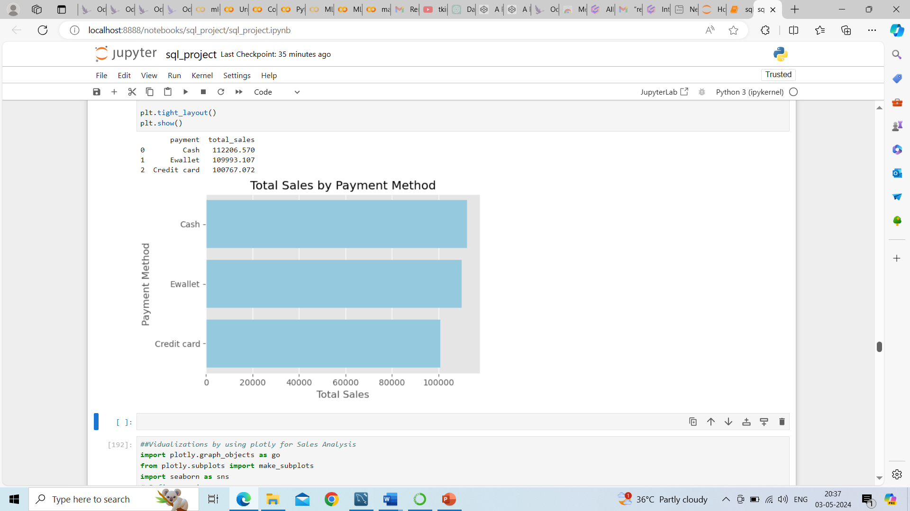
Exploratory Data Analysis: Data Visualization -bar plot
Sales Analysis:
7. Analyzed trends in sales by payment method to identify popular payment methods..
--Identified sales are more by cash payments than Ewallet and Credit card

Slide 23
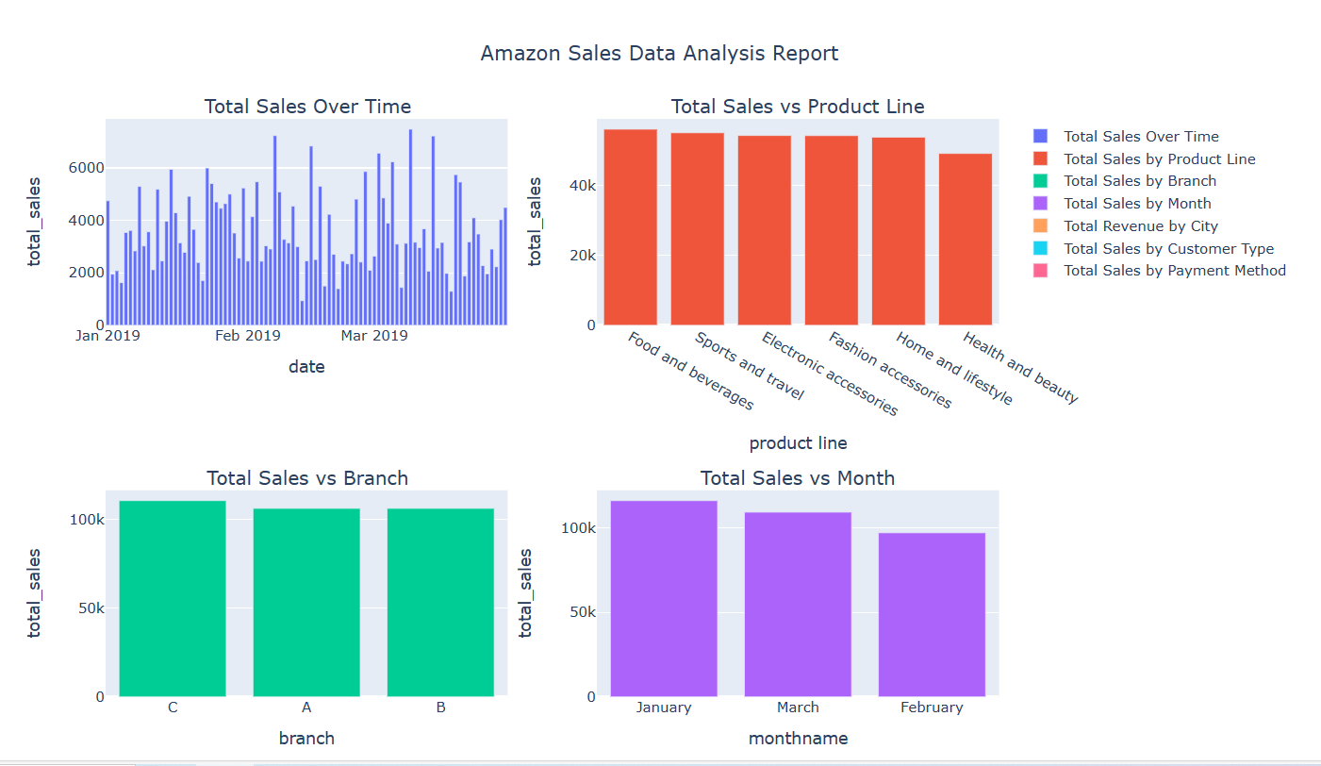

Slide 24
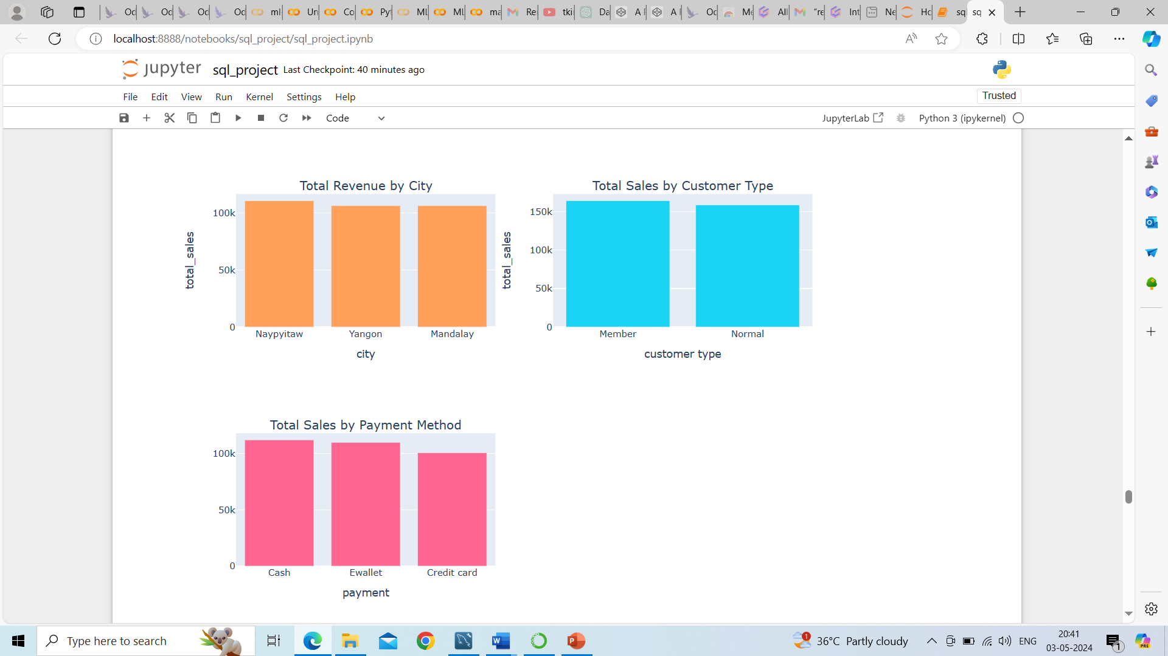

Slide 25
Exploratory Data Analysis: Data Visualization -bar plot
Customer Analysis:
1. Identified different customer segments based on their characteristics (e.g., customer type, gender, location).
2. Segment customers based on customer type
3. Segment customers based on gender
4. Calculated total sales for each customer segment
5. Calculated gross margin or profit for each customer segment
6. Identifed high-value customers based on total purchase amount

Slide 26
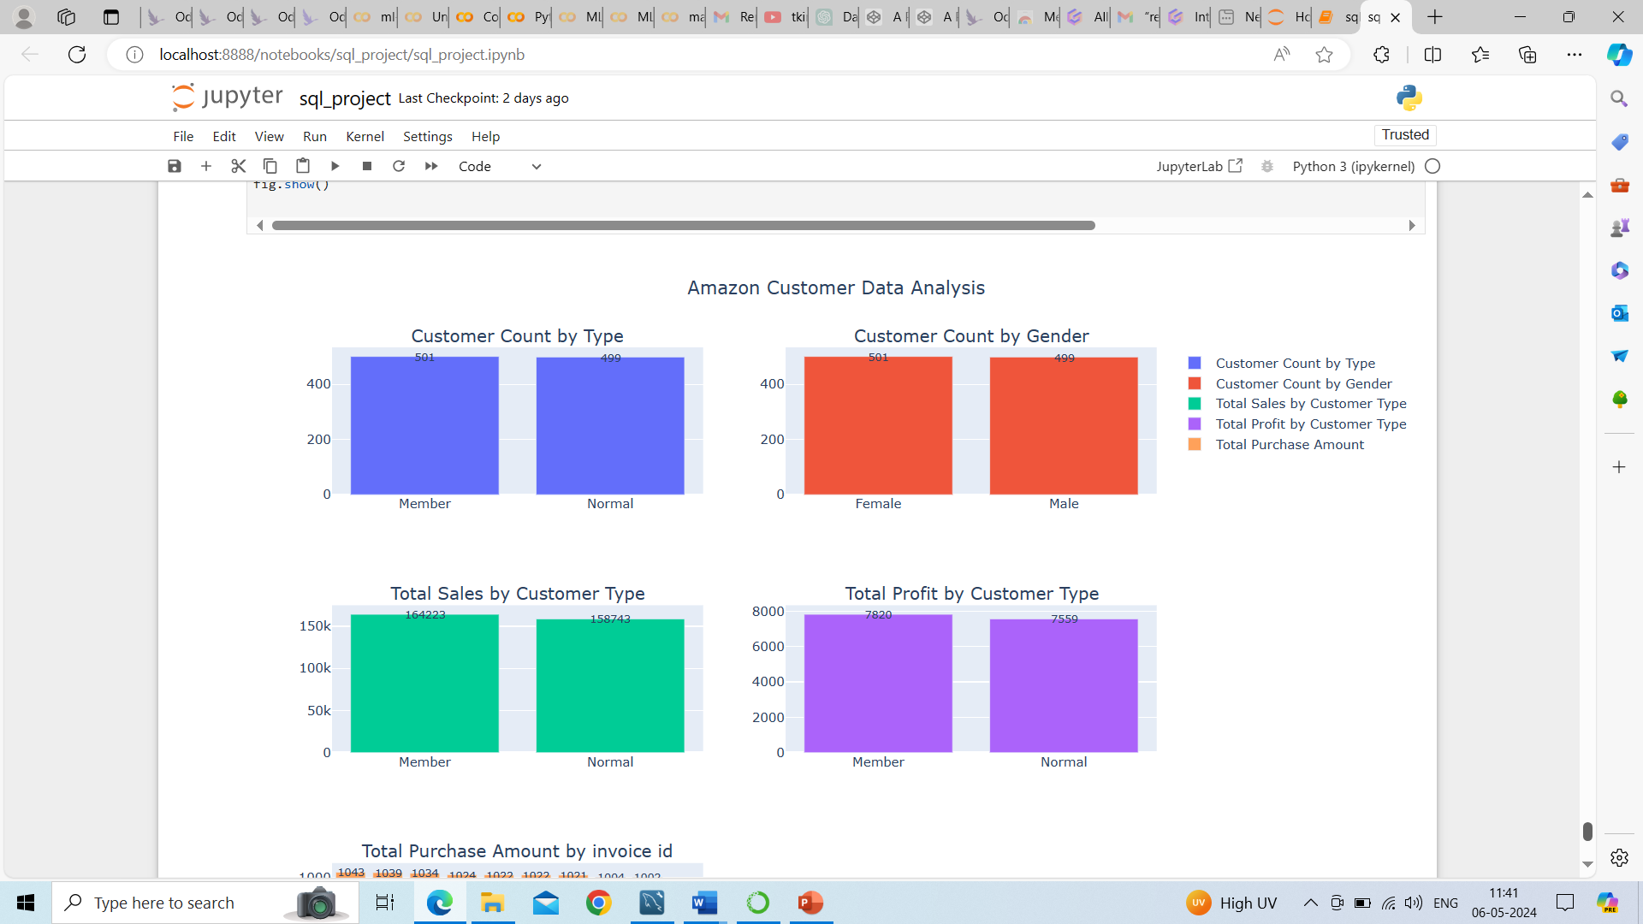
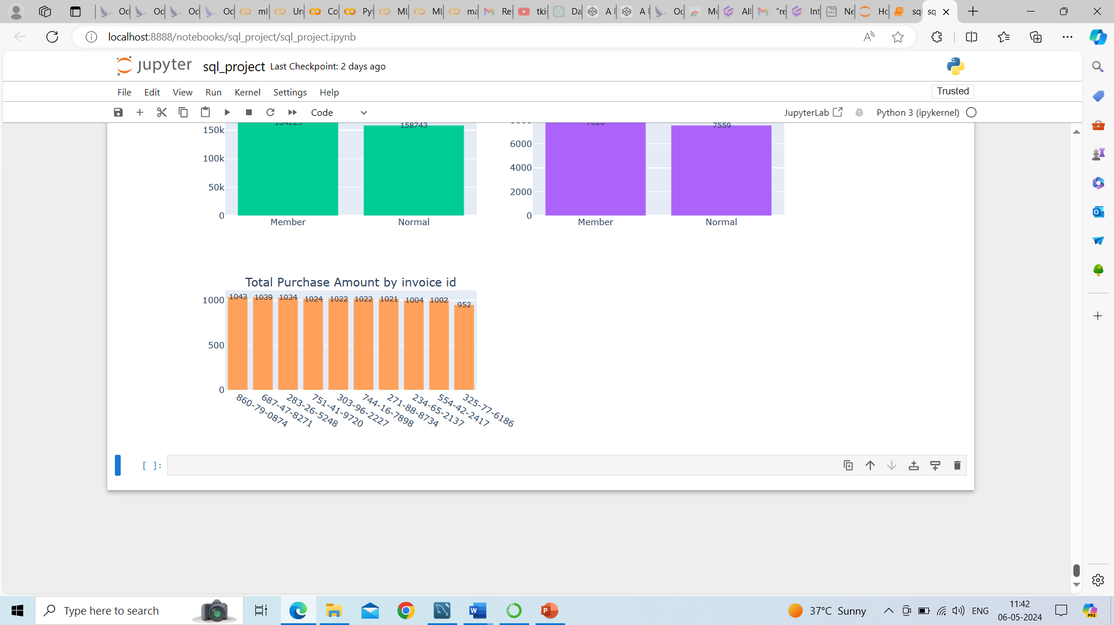

Slide 27
Results
This dataset contains sales transactions from three different branches A, B and C of Amazon, respectively located in Yangon , Mandalay and Naypyitaw and having 5 product lines namely Food and Beverages, sports and travel, home and lifestyle, Electronic accessories, Health and Beauty and Fashion accessories
This dataset contains 1000 rows and 17 columns. Added 3 more columns to identify trends over time like day wise, week wise and monthly wise.
There are two types of customers namely amazon members and normal customers.
There are 3 payment methods namely Ewallet,cash and credit card.
This data is generated during the period of Jan to mar of 2019.
This data set contains 2 types of genders males and females.
From the total customers, amazon membership customers are more than amazon normal customers.

Slide 28
In this,when we compare total sales with each product line
Food and Beverages generated highest sales and health and beauty generated lowest sales .
Avg sales of each product line, highest avg sales generated at home and life syle and lowest avg sales generated at Fashion accessories
The product lines Health and Beauty, sports & travel and Home & life style are performed above average performance and remaining done are below avg performance.
The product line “ Fashion accessories” is most frequently associated with each gender.
When we compare product line with ratings,
‘Food and beverages’ has highest average rating and Home and life style has lowest rating.
Highest ratings occurred during afternoon if we calculate with all branches.
Highest ratings occurred during afternoon with branch A ,if we calculate branch wise.
Highest avg ratings occurred on Monday if we calculate with all branches.
Highest ratings occurred during on monday with branch B ,if we calculate branch wise.
When we compare revenue over time,
Highest revenue generated in jan month and lowest revenue generated in feb 2019.
cost of goods sold reach its peak in the jan month and low in the month of feb 2019
sales occurrences are more in the afternnon on every weekday especially in Saturday afternoon.
Highest sales generated on march 9th , 2019 , lowest on feb 13th,2019.
Highest sales generated on jan, and lowest sales generated on feb.

Slide 29
When we compare revenue with city,
Highest revenue generated at city Naypyitaw and lowest revenue generated at city mandalay.
When we compare cutomertype with revenue,
customer type “members” occurs most frequently and Amazon members are generating highest revenue than normal customers. And total profit also high with the amazon members.
Females are more than males in amazon customers
Amazon members contributed more sales than normal customers
With the invoice id 860-79-0874 purchased more than other invoice id’s.
When we compare sales with respective branches,
branch c generated highest sales and low as branch B.
.when we compare sales with payments,
Sales are more by cash payments than ewallet and credit card.

Slide 30
Recommendations:
Additional analysis and strategies for improvement based on identified product lines.
Explore potential strategies to improve sales for these product lines, such as marketing campaigns, promotions, or product improvements.
Launch targeted marketing campaigns to promote top-selling products or product lines.
Optimize pricing strategies for products with below-average sales performance to increase competitiveness.
Enhance customer engagement through personalized recommendations or loyalty programs based on customer segmentation.
Improve inventory management processes to ensure adequate stock levels for high-demand products during peak seasons.
Invest in training and development programs to enhance sales team performance and customer service.
Expand product offerings or introduce new product lines based on emerging trends or customer preferences identified in the analysis.

Slide 31
THANKYOU

